Slide 1
Considerations for New STJ Array Designs
Goals:
• 128-pixel STJ arrays (number matched to the maximum of four 32-channel XIA preamps)
• Pixels will be “small” (70 µm)² with highest resolution for sterile neutrino search, “medium”
(130 µm)² for EXASF (and neutrinos?) and “large” (200 µm)² for largest area at synchrotron.
• Separate ground wire for each pixel. This will almost double number of bond pads from 144 to 256.
• Make 64-pixel arrays with (250µm)² bond pads so that we can test them with existing setup.
• Keep a few 128-pixel (130µm)² and (200µm)² arrays with 144 wires for synchrotron science.
(Standard) Considerations:
• Pixels will be rotated by 45˚ on chip to facilitate suppression of dc Josephson current.
• Bond pads are 200 x 300 µm² with 250 µm pitch. (Still possible? Can we use 100µm x 300µm pads
to keep the chip size at 1 cm²?) Wires are 10 µm wide, 15 µm pitch.
• Bond pads made from STJ base (?) layer, with 300 nm of Au on top (use thin Ti underlayer).
• Use same top electrode mask / photoresist pattern for anodization to passivate the junction edges.
(New) Considerations:
• 200 µm double-side polished (DSP) Si wafers allow backside etching of Si₃N₄ membrane.
• To prevent qp diffusion into the leads, leads (or qp block) must have a larger energy gap than STJ.
This matters for Al STJs, but not for Ta-STJs with Al traps. ⇒ Two separate wiring masks (?)
• Al base electrode layer forms base wiring. Since Nb is easier to deposit than Ta, we will use Nb leads.
• We will deposit an Au layer over most of the wafer to absorb and thermalize high-energy
phonons generated by interactions in the Si substrate. This requires an adhesion layer (like Ti).
• Test chips no longer need 25 µm and a 284 µm STJs. Use 70 µm, 130 µm and 200 µm only.
• Make additional masks for ⁷Be implantation and for Ta cap layer.

Slide 2
Existing STJ Dimensions
Nb
block
Anodization
Al-STJ
Nb wiring
~1 µm Si₃N₄
15 µm
Si bars
200µm Si
Considerations:
• ≥50 µm wide “bars” between
membranes can be made reliably.
• 5 µm overlap or spacing between
structures can be made reliably.
• Use Au as a phonon thermalizer.
• Anodization of junction edges serves
as insulator to avoid shorts from Nb
• Add Pb absorber for EXAFS STJ, but
not for BeEST STJs
I don’t think any of the dimensions are critical, and they are chosen (at least initially) for reliability.
These considerations imply a (minimum) spacing of 80 µm between STJs.
≥50µm
10µm
5µm
Nb
wiring
STJ dimensions
differ based on application
Al
wiring
Au thermalizer

Slide 3
Proposed STJ Dimensions
Nb block
(right side)
Anodization
Al-STJ
Nb wiring
~1 µm Si₃N₄
15 µm
Si bars
200µm Si
Considerations:
• ≥50 µm wide “bars” between membranes
can be made reliably. The SiN membrane is
15µm bigger than the STJ on all sides.
⇒ Pixel spacing is “STJ size + 30µm + 50µm =
STJ size + 80µm within a row of pixels.
• 5 µm overlap or spacing between
structures can be made reliably.
• 10µm wide Nb and Al wires
• 20µm wide Nb plugs on Al wire
• 10µm spacing between Nb and Al wire
(at STJ. Otherwise 5µm spacing as usual)
• Use Au as a phonon thermalizer.
• Anodization of junction edges serves
as insulator to avoid shorts from Nb
The 8 pairs of wires (15µm pitch) are 240 µm wide. I want a least 30 µm of Au around (most of) the STJs. That sets the spacing between rows to STJ+30+240+30 = STJ+300µm
≥50µm
10µm
5µm
Nb
wiring
STJ dimensions
differ based on application
Al
wiring
Au thermalizer

Slide 4
Layout of Existing 8 x 1 STJ Array Module
Au
Signals Ground
Au
STJ
60 µm
STJ
Au
SiN
10µm
15µm
Si bar
Redesign with separate ground
wiring for each pixel.
STJ + 30µm
50 µm
• Robin suggests 1 STJ per membrane for improved stability.
• Linear sub-arrays simplify wiring layout for large arrays.
• 8 pixels share one ground wire, i.e. 32 pixels will require 36 wires.
64 pixels can be read out with a single 78-pin loom and connector.
• Nb wires can be routed between Au thermalizers.
• Pixel spacing of (STJ+80 µm) within 8 x 1 array module is set by 50 µm
width of Si bar and 2 x 15 µm space between Si bar and STJ.
• Module spacing of (STJ width +210 µm) is set by (8+1)x 15µm wiring
pitch plus (say) 25 µm minimum width of Al thermalizer. Modules
with 70 (130, 200) µm pixels will have 280 (340, 410) µm pitch.
• All base layers must be electrically connected for anodization.
Check how this affects the mask layout for the leads.
Signal wires of next array module
STJ+80µm
140 µm
40 µm
STJ + 30µm

Slide 5
Proposed Layout of 8 x 1 STJ Array Module
Au
Au
STJ
60 µm
STJ
Au
SiN
10µm
15µm
Si bar
STJ + 30µm
50 µm
• Robin suggests 1 STJ per membrane for improved stability.
• Linear sub-arrays simplify wiring layout for large arrays.
• One ground wire per pixel, i.e. 32 pixels will require 64 wires.
128 pixels are read out with four 78-pin looms and connector.
• Pixel spacing of (STJ+80 µm) within 8 x 1 row of STJs is set by 50 µm
width of Si bar and 2 x 15 µm space between Si bar and STJ.
• Row spacing of (STJ width + 300 µm) is set by 2x8x 15µm wiring
pitch plus 2x15µm SiN width plus 30µm minimum width of Al
thermalizer. Rows of 70 (130, 200) µm pixels will therefore have
370 (430, 500) µm pitch.
• All base layers must be electrically connected for anodization.
This requires Nb plugs to be deposited first.
STJ+80µm
30µm
240 µm
STJ + 30µm

Slide 6
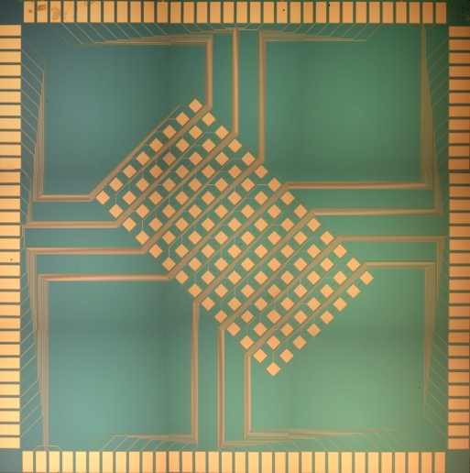
9 mm for bond pads
1…
…36
9 + 9 + 9 + 9 wires
37
We now need 32 or 64 bond pads
on each edge for 64 and 128 pixels.
How small can we make them?
STJ+210µm
pitch
Considerations:
• 72 wires use 1 loom
+78-pin D-connector
• 200 µm x 300 µm
bond pads
• 250 µm pitch x 36
bond pads = 9 mm
• Use 1 cm² chip size
for 128-pixel arrays.
10 mm x 10 mm chip size
STJ+80µm
pitch
Existing 112-pixel Ta-STJ Arrays
9 + 9 + 9 + 9 wires
72
Pixel pitch?

Slide 7
8 mm for bond pads
1…
…32
128
16 + 16 wires
33
Considerations for 64-pixel arrays:
• 200 µm x 300 µm
bond pads as before
• 32 pads per side
• 250 µm pitch x 32
bond pads = 8 mm
• Use 1 cm² chip size
for 128-pixel arrays.
• Bond pads must be
symmetric under
90˚ rotations. (On all
sides, start with pad
for signals.)
• Array must be
centered (so that Si
mask does not depend
on orientation).
STJ+300µm
pitch
STJ+80µm
pitch
16
+16
wires
10 mm x 10 mm chip size
16
+16
wires
STJ+80µm
pitch
97
16 + 16 wires
64
96
65
Pixel pitch?

Slide 8
9.6 mm for bond pads
1…
…64
256
16 + 16 + 16 + 16 wires
65
Considerations for 128-pixel arrays:
• 100 µm (?) x 300 µm
bond pads
• 64 pads per side
• 150 µm pitch x 64
bond pads = 9.6 mm
• Use 1 cm² chip size
for 128-pixel arrays.
• Bond pads must be
symmetric under
90˚ rotations. (On all
sides, start with pad
for signals.)
• Array must be
centered (so that Si
mask does not depend
on orientation).
STJ+300µm
pitch
16
+16
+16
+16
wires
16
+16
+16
+16
wires
10 mm x 10 mm chip size
STJ+80µm
pitch
193
16 + 16 + 16 + 16 wires
128
192
129
Pixel pitch?
PCBs with a 150µm pitch are pushing the limits SF Circuits.

Slide 9
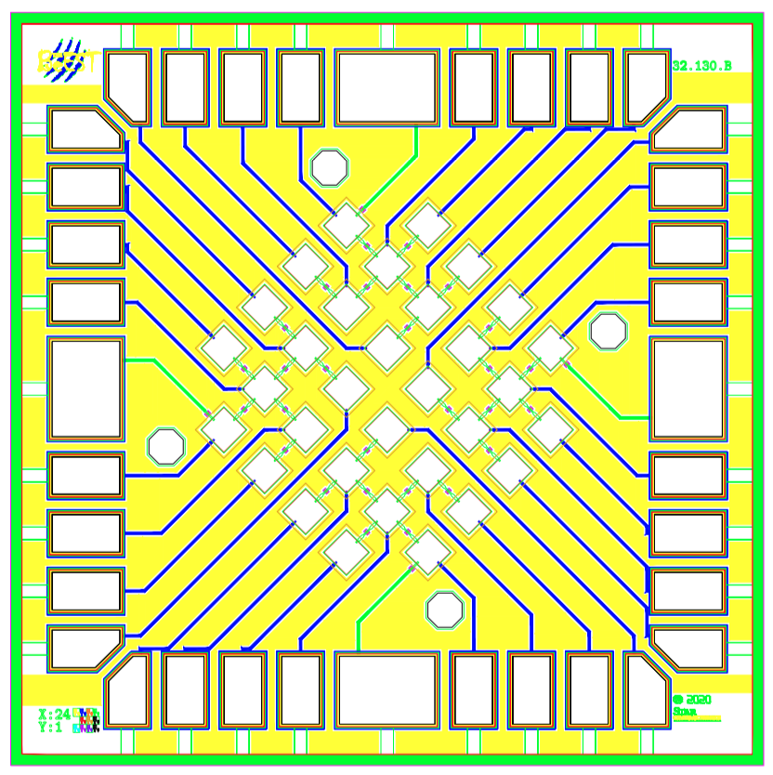
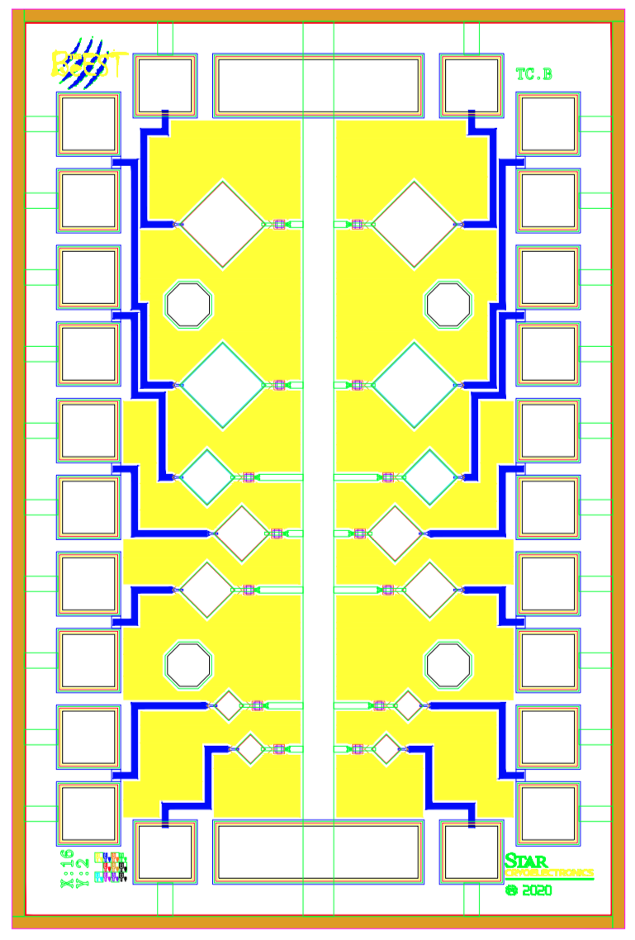
Mask Layout of Test Chip and 32-STJ Array ⇒ Update
2 mm
3 mm
(200µm)²
←SUV8 posts→
3 mm
(130µm)²
(70µm)²

Slide 10
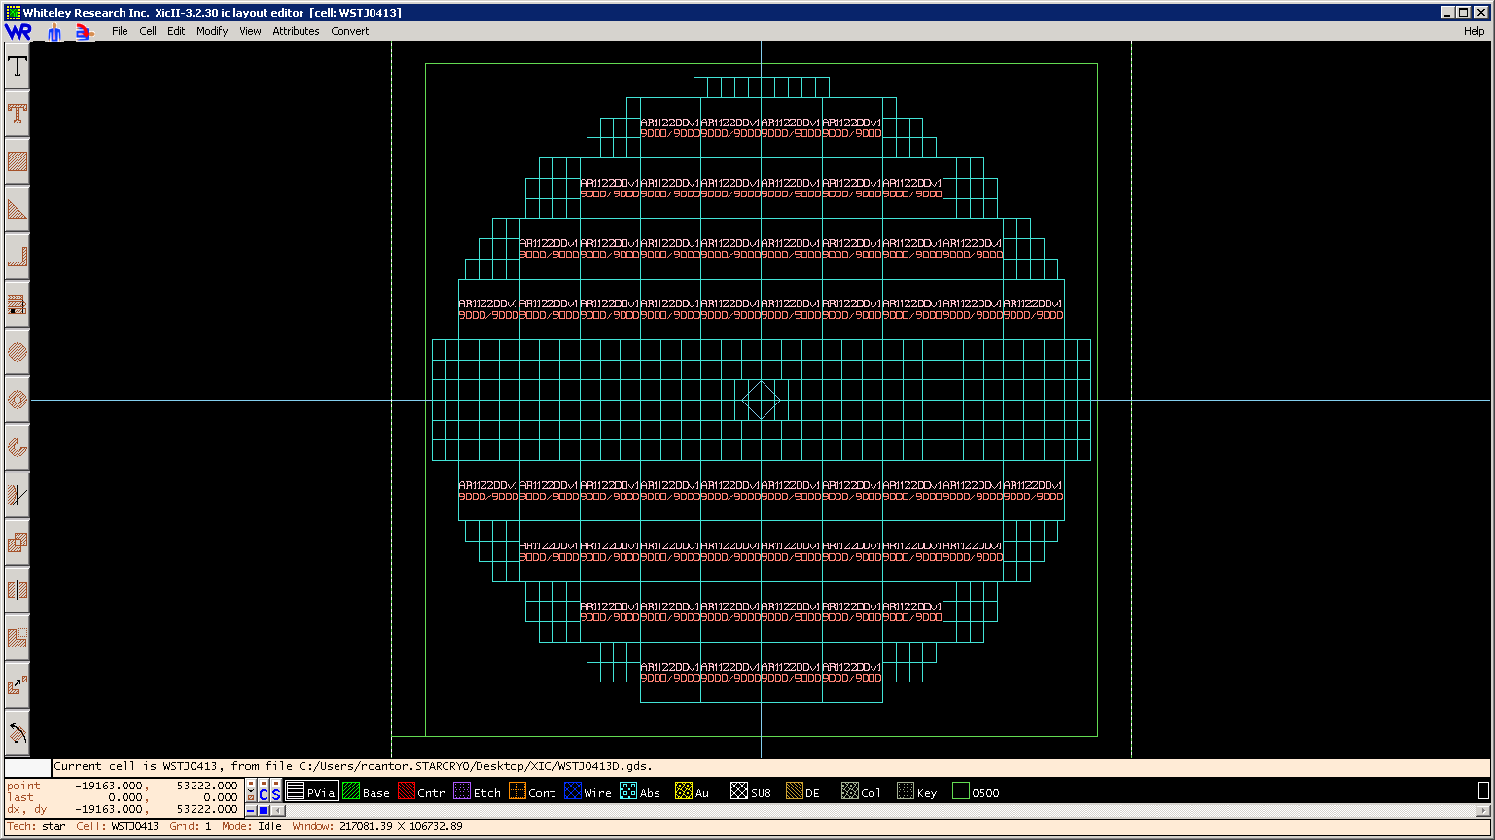
Layout of Existing 4” Wafer ⇒ Update
Chips near edge of wafer
“not very useful”
3mm pitch ↓
↓ 2mm pitch
Top “big piece”
First
Cut →
Always
3mm pitch
in this
direction →
Second
Cut →
Middle “big piece”
Bottom “big piece”
Is this what you do, Robin?

Slide 11
Existing Layout of 4” Wafer ⇒ Update
Considerations
• On the wafer, we want:
– (10mm)² 128-pixel arrays of (70µm)²,
(130µm)² and (200µm)² STJs
– (3mm)² 36- pixel arrays of (70µm)²,
(130µm)² and (200µm)² STJs
– Many (2mm x 3 mm) test chips
• Film thicknesses are optimized in the
center of the wafer, so we want chips of
all types near the center.
• We want to be able to dice the wafer
relatively easily without re-mounting
• The current layout gives
– 42 (10mm)² chips with 128-pixel arrays
– 96 (3mm)² chips with 36-pixel arrays
– 192 (2mm x 3mm) test chips
1cm ≈ 0.4”
1 5
6 12
13 21
1cm ≈ 0.4”
6 x 2mm
3 x 3mm
22 30
31 37
38 42

Slide 12
Considerations for Updated Layout of 4” Wafer
Current Pixel Sizes and Wafer Layout
Pixel Size with Separate Grounds
Bond Pad Pitch | 128 pixels | 64 pixels | 32 pixels | Test chip
250 µm | 10mm | – | 3mm | 2x3
Bond Pad Pitch | 128 pixels | 64 pixels | 32 pixels | Test chip
250 µm | 16mm | ≥8mm | 4mm
200 µm | 13mm | 7mm | 3.2
150 µm | 10mm | 5mm
1cm ≈ 0.4”
1 5
6 12
13 21
• How many 128-, 64- and 32-pixel arrays
do we want on the wafer? (AMAP)
• Do we need them in all pixel sizes? (No)
• Do we want array designs with shared
ground wiring on the chip? (Probably. A few.)
⇒ Need 10mm pixel sizes
• Is STAR setup matched to 2x3mm test chips?
• We will never run >32 pixels in R2D2
⇒ Need 32-pixel arrays with separate gnd.
⇒ Need 4mm (or 4.5mm) dies.
• We want to be able to dice the wafer
relatively easily without re-mounting
1cm ≈ 0.4”
6 x 2mm
3 x 3mm
22 30
31 37
38 42

Slide 13
Option 1 for Updated Layout of 4” Wafer
Current Pixel Sizes
Pixel Size with Separate Grounds
Bond Pad Pitch | 128 pixels | 64 pixels | 32 pixels | Test chip
250 µm | 10mm | – | ≥3mm | 2x3
Bond Pad Pitch | 128 pixels | 64 pixels | 32 pixels | Test chip
250 µm | 16mm | ≥8mm | 4mm | 2x3
200 µm | 13mm | 7mm | 3.2
150 µm | 10mm | 5mm
1cm ≈ 0.4”
(twenty one 10mm x 10mm chips)
64-STJ and 128-STJ arrays with common gnd
• How many 128-, 64- and 32-pixel arrays
do we want on the wafer? (AMAP)
• Do we need them in all pixel sizes? (No)
• Do we want array designs with shared
ground wiring on the chip? (Probably. A few.)
⇒ Need 10mm pixel sizes
• Is STAR setup matched to 2x3mm test chips?
• We will never run >32 pixels in R2D2
⇒ Need 32-pixel arrays with separate gnd.
⇒ Need 4mm (or 4.5mm) dies.
• We want to be able to dice the wafer
relatively easily without re-mounting
1cm ≈ 0.4”
2x3mm²
Draft. Fix.
(4.5mm)²
13mm ≈ 0.52”
128-pixel arrays with separate grounds
(ten 13mm x 13mm chips)
SF Circuits (and Avanti PCB) can do PCBs with 200µm pitch.

Slide 14
Option 2 for Updated Layout of 4” Wafer
Current Pixel Sizes
Pixel Size with Separate Grounds
Bond Pad Pitch | 128 pixels | 64 pixels | 32 pixels | Test chip
250 µm | 10mm | – | ≥3mm | 2x3
Bond Pad Pitch | 128 pixels | 64 pixels | 32 pixels | Test chip
250 µm | 16mm | ≥8mm | 4mm | 2x4.5
200 µm | 13mm | 7mm | 3.2
150 µm | 10mm | 5mm
1cm ≈ 0.4”
(twenty one 10mm x 10mm chips)
64-STJ and 128-STJ arrays with common gnd
• How many 128-, 64- and 32-pixel arrays
do we want on the wafer? (AMAP)
• Do we need them in all pixel sizes? (No)
• Do we want array designs with shared
ground wiring on the chip? (Probably. A few.)
⇒ Need 10mm pixel sizes
• Is STAR setup matched to 2x3mm test chips?
• We will never run >32 pixels in R2D2
⇒ Need 32-pixel arrays with separate gnd.
⇒ Need 4mm (or 4.5mm) dies.
• We want to be able to dice the wafer
relatively easily without re-mounting
1cm ≈ 0.4”
4 x 2mm
Draft. Fix.
3 x 4.5mm
16.5mm ≈ 0.65”
128-pixel arrays with separate grounds
(six (16.5mm)² chips)

Slide 15
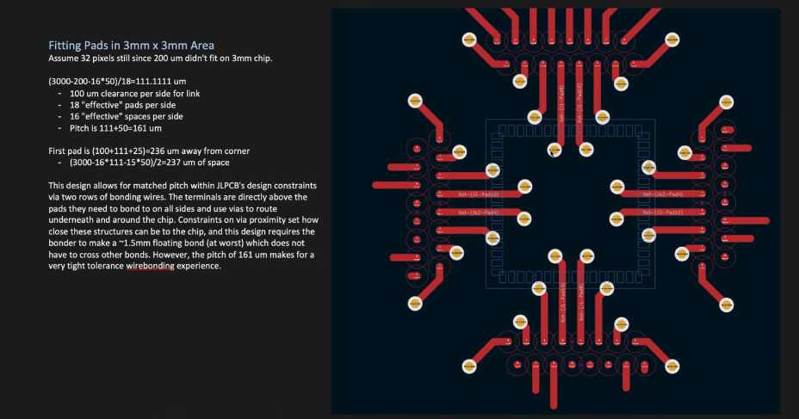
PCB Option for 150µm Bond Pad Pitch?
This multi-layer PCB wiring layout is compatible with 150µm bond pad pitch.
Is this doable?

Slide 16
Considerations for Implantation and Cap Layer Masks
Mask for ⁷Be implantation:
• We want area as large as possible without implanting into the STJ edges…
• … and still be able to cover all Be-7 implants under a cap layer deposited onto the chip.
⇒ Collimator mask is 10 µm smaller than STJ on all sides
⇒ Cap layer mask is 5 µm smaller than STJ on all sides
• We only need a single mask for all different array sizes, because we will process individual chips
for Be-7 implantation (not full wafers)
Mask for Cap Layer:
• We probably need a separate mask (with 5µm smaller patterns) for cap layer patterning.
Incomplete. Double-check!
Pre-2018 STJ Chips | Hole spacing
Test chip | ?
6x6 (200µm)² pixels | 50 µm between pixels
7x16 (200µm)² pixels | 150 µm between pixels
Existing post-2018 Chips | Hole spacing
Test chip
Still need 6x6 arrays? | Yes, 30-50, 3x3mm²
8x16 (70µm)² pixels | 100 µm x 200 µm
8x16 (130µm)² pixels | 160 µm x 260 µm
8x16 (200µm)² pixels | 230 µm x 330 µm
Pattern dimensions for new masks still TBD.

Slide 17

Proposed Layout of Si Collimators ⇒ Update
Existing Test Chip:
• Nominally 2 x 3 mm², but cut with 0.1 mm saw
• (0.2mm)² bond pads, 0.25mm pitch
Want: Six 30 µm (different options 50 µm ok) holes over central STJs
• 25 µm traces (make 100 µm wide for safety)
Existing 128-pixel chips:
Want: 128 square holes in (8mm)² collimator
70µm STJs: (50µm)² holes, 150 x 280 µm pitch
130µm STJs: (110µm)² holes, 210 x 340 µm pitch
200µm STJs: (180µm)² holes, 280 x 410 µm pitch
~1.9mm chip
0.25mm
0.65mm
0.25mm
Pitch:
STJ size
+ 80 µm
Pitch:
STJ size + 210 µm
0.75mm
208µm STJs
8 mm collimator
~2.25mm collimator
~2.9mm chip
138µm STJs
0.375mm
68µm STJs
0.25mm
0.875mm
8 mm collimator
~9.9 mm chip
~1.15mm collimator

Slide 18
First Task (Suggestion): Redesign Test Chip
Goals:
• Learn the AutoCAD(?) / XIC design process
• Create something simple to run by Robin
– Same designs can be used in arrays.
Design:
• 14 pixels on 2mm x 3mm chip as before
• 70 µm, 130 µm and 200 µm pixel areas
• Separate grounds ⇒ 28 bond pads total
• Pads connects at cut to allow anodization
• Two wiring masks (with an without Nb plug)

Slide 19
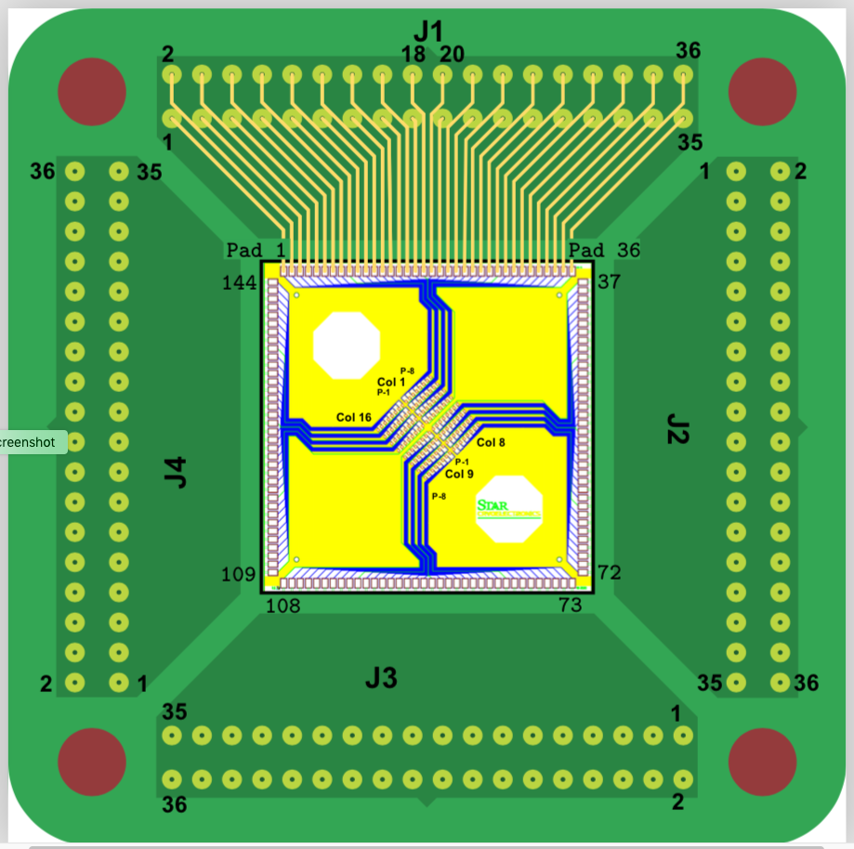
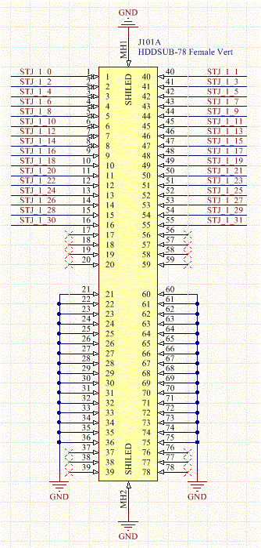
Block Diagram of Current STAR Cryo Wiring
Want:
• Each pixel has separate ground wire
• Each pixel is read out with a twisted pair of wires
• Grounds are connected on preamp board only.
• Arrays can be read out with existing wiring.
Must keep wiring at STAR Cryo:
• Twisted pairs to 1K, 36-pin to 44-pin PCB at 1K
• Twisted pairs to 4K, 44-pin to 78-pin PCB at 4K
• Twisted pairs to 300K, 78-pin input to preamps
At 0.1K:
4 connectors (J1 – J4)
At 1K:
PCB from 4x 36-pin
to 4x 44-pin sub-D
At 4K:
PCB from 4x 44-pin
to 4x 78-pin sub-D
At 300K:
4x preamplifier cards, each with 78-pin D-sub
36-pin SamTec connectors
44(!)-pin sub-D connectors
44(!)-pin sub-D connectors
78-pin sub-D connectors
No need to
re-design.
Must be
re-designed.
Pins 1 and 2, 3 and 4,…35 and 36 are twisted pairs on J1 to J4.

Slide 20
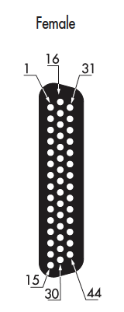
Twisted Pairs on 44-Pin sub-D connector at 4K
pair #10 #11 #12 #13 #14 #15 #16 #17 #18
pair #1 #2 #5 #3 #4 #6 #7 #8 #9
Not used
Pair #1 and #18 are not used for 64-pixel chips with only 32 bond pads / wires per side

Slide 21
Twisted Pairs on 78-Pin sub-D connector at 300K
Pin16
Pins17-20: not used
Pins37-39: not used
Pin55:
Pins 1
Pin 21
Pin 40
Pin 60
Pins56-59: not used
Pins76-78: not used
Neighboring pins within the same row are twisted pairs according to:
Pins 1 and 2, pins 3 and 4, pins 5 and 6,… pins 21 and 22, pins 23 and 24
This does not match the intended pin assignment on the XIA preamp.
(But neither does it keep is from building a 4K PCB to match the right wires.
It might, however, cause some crosstalk.)

Slide 22
Pin Assignment at Preamplifier
Pin1: STJ0
Pin16: STJ30
Pin55:
STJ31
Pin40: STJ1
Pins17-20: not used
Pins37-39: not used
Row 1 (pins 1-20):
Even # Channels: STJ0, STJ2,…
Row 2 (pins 21-39):
Ground for all even # Chns
Row 3 (pins 40-59):
Odd # Channels: STJ 1, STJ3,…
Pins56-59: not used
Pins76-78: not used
Row 4 (pins 60-78):
Ground for all odd # Chns
Neighboring pins are assigned to twisted pairs according to:
For even channels: Pins 1 and 21, pins 2 and 22, pins 3 and 23,… pins 16 and 36
For odd channels: Pins 40 and 60, pins 41 and 61, pins 42 and 23,… pins 55 and 75

